Slide 1
Anonymous Routing
Dhanashree D, Jayasri P A , Kaushik S, S Rathan Aswath
Security Interns, MARS Lab @ IIT Guwahati
Under guidance
Dr. John Jose
IIT Guwahati

Slide 2
Anonymous Routing
Anonymous routing is a secure routing mechanism in which the source and destination addresses from head flit is encrypted along with body flit in order to hide the data being transmitted.
It helps to protect sensitive information from getting leaked to Malicious router by preventing Trojan attacks such as Eavesdropping, Denial Of Service attacks, Packet Tampering etc. .
The intermediate routers between the source and the destination cannot decrypt the data packets and it passes to nearby router according to the algorithm that is followed.
One of many traditional anonymous routing schemes is Onion routing, but it is not optimal since NoCs are resource constrained. While anonymous routing can be performed with MANETS in an Optimal manner it does not satisfy the Communication Requirement of NoC.

Slide 3
Dynamic XY Routing (D_{y}XY)
Dynamic XY routing is an enhanced version of XY routing. It is capable to find the shortest path from source to Destination router.
It is Deadlock free
In D_{y}XY, if the Destination router is on the same axis (X-axis or Y-axis) as the Source router then similar to XY routing the data packet travels in the same axis with just one choice until the destination is reached.
In D_{y}XY upon every time a data packet moves from one router to another router, at each router two choices are available to move towards destination. One choice will be either East/West and the other choice will be either North/South.
These choices will be dependent on the basis of the location of the destination.
The method we follow will calculate a path which can be one of the paths (Subset) from D_{y}XY routing.
And since D_{y}XY has been proved to be Deadlock free, the path generated by our algorithm will also be deadlock free

Slide 4
Packet Format
……
F_{b}
Op_{y}
Op_{x}
PFR
Flit Type
VC_{id}
P_{id}
SA
DA
B₁
B_{n}
Tail
Encrypted Flits
F_{b} / Flip Bit gives the direction by which the flip should occur (x-axis[0] or y-axis[1]).
Op_{x} (Output Port on x-axis) gives the direction the packet should travel along x-axis(East[0] or West[1]).
Op_{y} (Output Port on y-axis) gives the direction the packet should travel along y-axis(North[0] or South[1]).
PFR (Pre Flip range) gives the total no. of hops required to be taken before flip occurs.
Header fields : path info Body Field carrying data Tail Field

Slide 5
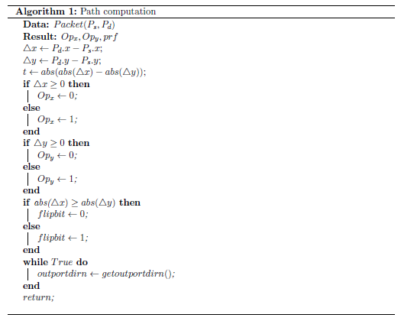
Algorithm 1 : Path Computation

Slide 6
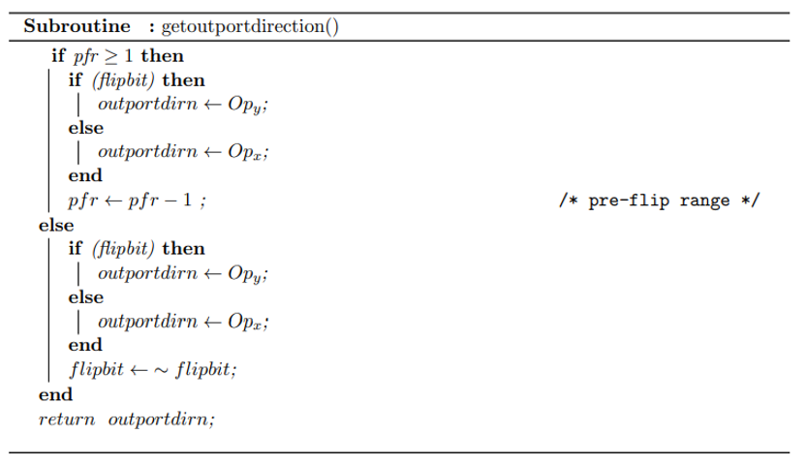
Subroutine : getoutportdirection()

Slide 7
Proposed Algorithm
Here ∆x is the difference between x-axis co-ordinates of source and destination and ∆y is for y-axis which is used to calculate pfr() which tells the amount of routers we should travel initially along with x or y axis.
At first, the source calculates the values for pfr,Op_{x} ,Op_{y} . Op_{x} is set to East if ∆x is greater than or equal to zero else it is set to West. Then Op_{y} is set to North if ∆y is greater than or equal to 0 or else it is set to South.
Flipbit is set to 0 or 1 to indicate which Outport the packet should leave the router. Here 0 indicates x-axis(East or West) and 1 indicates y-axis(North or south).The Flipbit is initially set at Source based on the value of ∆x and ∆y. If ∆x is greater then Flipbit is set to 0, if ∆y greater then Flipbit is set to 1.
If the value of pfr is greater than zero it is decremented upon travelling to every router until it becomes 0. The Data packet travels in the same direction initialized by source until pfr becomes 0.
Once pfr becomes 0 then Flipbit changes according to its current value .i.e. if Flipbit is 1 while entering the router then it is set to 0 or if Flipbit is 0 while entering the router then it is set to 1.
The data packet travels in the zig-zag manner until it reaches the Destination where the Encrypted part of the flit can be deocoded.

Slide 8
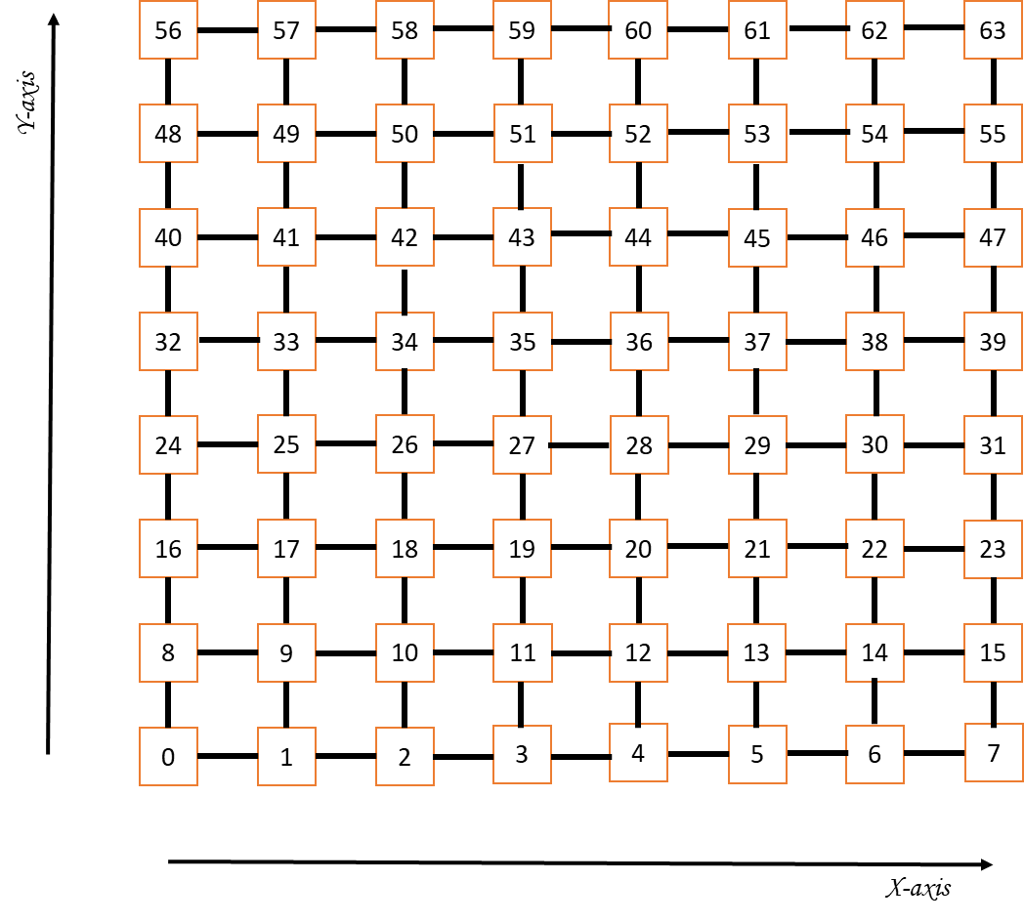
Possible Paths through D_{y}XY
Source : 10
Destination : 53
Path found in
our proposed algorithm

Slide 9
Source : 10
Destination : 53
Current Head Fields values
1
0
0
1
0
0
1
0
0
2
1
1

Slide 10
`
Source : 44
Destination : 17
Current Head Fields values
0
0
1
0
1
1
0
0
1
1

Slide 11
`
Source : 23
Destination : 19
Current Head Fields values
0
1
0
2
4
3
1

Slide 12
Thank You !

